Slide 1
PL/SQL
Introduction
Structure of a block
Variables and types
Accessing the database
Control flow
Cursors
Exceptions
Procedures and functions
Triggers
BD05/06

Slide 2
Introduction
PL/SQL stands for Procedural Language/SQL.
The basic unit in PL/SQL is a block. All PL/SQL programs are made up of blocks, which can be nested within each other. Typically, each block performs a logical action in the program.
BD05/06

Slide 3
Structure of PL/SQL
HEADER
Type and Name of block
DECLARE
Variables; Constants; Cursors;
BEGIN
PL/SQL and SQL Statements
EXCEPTION
Exception handlers
END;

Slide 4
Structure of PL/SQL
DECLARE
a number;
text1 varchar2(20);
text2 varchar2(20) := “HI”;
BEGIN
---------- ---------- ----------
END;
Important Data Types in PL/SQL include NUMBER, INTEGER, CHAR, VARCHAR2, DATE etc
to_date(‘02-05-2007','dd-mm-yyyy') { Converts String to Date}

Slide 5
Block (2)
PL/SQL is not case sensitive. C style comments (/* ... */) may be used.
To execute a PL/SQL program, we must follow the program text itself by: a line with a single dot ("."), and then a line with “run”; or a line with “/”
We can invoke a PL/SQL program either by typing it in sqlplus or by putting the code in a file and invoking the file
BD05/06

Slide 6
Variables and Types (1)
Information is transmitted between a PL/SQL program and the database through variables.
Every variable has a specific type associated with it, that can be:
  A generic type used in PL/SQL such as NUMBER
  Declared to be the same as the type of some database column
BD05/06

Slide 7
Variables and Types (2)
The most commonly used generic type is NUMBER. Variables of type NUMBER can hold either an integer or a real number.
The most commonly used character string type is VARCHAR(n), where n is the maximum length of the string in bytes. This length is required, and there is no default.
BD05/06

Slide 8
Example
DECLARE
price NUMBER;
myB VARCHAR(20);
v_flag BOOLEAN := FALSE;
BD05/06

Slide 9
The %TYPE attribute
A PL/SQL variable can be used to manipulate data stored in a existing relation.
The variable must have the same type as the relation column. If there is any type mismatch, variable assignments and comparisons may not work the way you expect.
To be safe, instead of hard coding the type of a variable, you should use the %TYPE operator.
Ex:
DECLARE myBeer Beers.name%TYPE;
gives PL/SQL variable myBeer whatever type was declared for the name column in relation Beers.
BD05/06

Slide 10
The %ROWTYPE attribute
A variable may also have a type that is a record with several fields.
The simplest way to declare such a variable is to use %ROWTYPE on a relation name. The result is a record type in which the fields have the same names and types as the attributes of the relation.
Ex:
DECLARE beerTuple Beers%ROWTYPE;
makes variable beerTuple be a record with fields name and manufacture, assuming that the relation has the schema Beers(name, manufacture).
BD05/06

Slide 11
Default values and assignments
The initial value of any variable, regardless of its type, is NULL.
We can assign values to variables, using the ":=" operator.
The assignment can occur either immediately after the type of the variable is declared, or anywhere in the executable portion of the program.
BD05/06

Slide 12
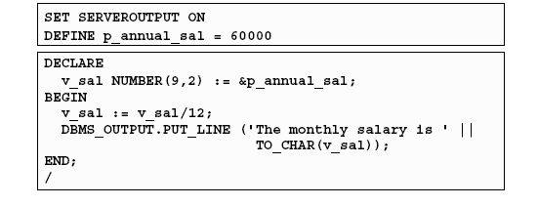
DBMS_OUTPUT.PUT_LINE package
An Oracle-supplied packaged procedure
An alternative for displaying data from a PL/SQL block
Must be enabled in SQL*Plus with: SET SERVEROUTPUT ON
BD05/06

Slide 13
Simple programs accessing the database
The simplest form of program has some declarations followed by an executable section consisting of one or more of the SQL statements with which we are familiar.
After the SELECT clause, we must have an INTO clause listing variables, one for each attribute in the SELECT clause, into which the components of the retrieved tuple must be placed.
The SELECT statement in PL/SQL only works if the result of the query contains a single tuple. If the query returns more than one tuple, you need to use a cursor
BD05/06

Slide 14
Example (SQL)
CREATE TABLE T1(
e INTEGER,
f INTEGER );
DELETE FROM T1;
INSERT INTO T1 VALUES(1, 3);
INSERT INTO T1 VALUES(2, 4);
BD05/06

Slide 15
Example (PL/SQL)
DECLARE
a NUMBER;
b NUMBER;
BEGIN
SELECT e,f INTO a,b FROM T1 WHERE e>1;
INSERT INTO T1 VALUES(b,a);
END;
/
Run: @filename.sql
BD05/06

Slide 16
Control flow
PL/SQL allows you to branch and create loops in a fairly familiar way.
An IF statement looks like:
IF <condition> THEN <statement_list>
ELSE <statement_list>
END IF;
The ELSE part is optional. If you want a multiway branch, use:
IF <condition_1> THEN ...
ELSIF <condition_2> THEN ... ... ...
ELSIF <condition_n> THEN ...
ELSE ...
END IF;
BD05/06

Slide 17
Example
DECLARE
a NUMBER;
b NUMBER;
BEGIN
SELECT e,f INTO a,b FROM T1 WHERE e>1;
IF b=1 THEN
INSERT INTO T1 VALUES (b,a);
ELSE
INSERT INTO T1 VALUES (b+10,a+10);
END IF;
END;
run
BD05/06

Slide 18
Loops
Loops are created with the following:
LOOP
  <loop_body> /* A list of statements. */
  END LOOP;
At least one of the statements in <loop_body> should be an EXIT statement of the form
EXIT WHEN <condition>;
The loop breaks if <condition> is true.
BD05/06

Slide 19
Example
DECLARE
i NUMBER := 1;
BEGIN
LOOP
INSERT INTO T1 VALUES (i,i);
i := i+1;
EXIT WHEN i>100;
END LOOP;
END;
run
BD05/06

Slide 20
Other useful loop-forming statements
A WHILE loop can be formed with:
WHILE <condition> LOOP
<loop_body>
END LOOP;
A simple FOR loop can be formed with:
FOR <var> IN <start>..<finish> LOOP
<loop_body>
END LOOP;
Here, <var> can be any variable; it is local to the for-loop and need not be declared. Also, <start> and <finish> are constants.
BD05/06

Slide 21
Cursors
A cursor is a variable that runs through the tuples of some relation.
  Can be a stored table or the answer to some query.
By fetching into the cursor each tuple of the relation, we can write a program to read and process the value of each such tuple.
If the relation is stored, we can also update or delete the tuple at the current cursor position.
BD05/06

Slide 22
Example (1)
Uses T1(e,f) whose tuples are pairs of integers.
The program will delete every tuple whose first component is less than the second, and insert the reverse tuple into T1.
BD05/06

Slide 23
Example (2)
DECLARE
a T1.e%TYPE;
b T1.f%TYPE;
CURSOR T1Cursor IS
SELECT e, f FROM T1 WHERE e < f ;
BEGIN
OPEN T1Cursor;
LOOP
FETCH T1Cursor INTO a, b;
EXIT WHEN T1Cursor%NOTFOUND;
DELETE FROM T1 WHERE CURRENT OF T1Cursor;
INSERT INTO T1 VALUES(b, a);
END LOOP;
CLOSE T1Cursor;
END;
BD05/06

Slide 24
Exceptions
An exception is an identifier in PL/SQL that is raised during execution.
• How is it raised?
– An Oracle error occurs.
– You raise it explicitly.
• How do you handle it?
– Trap it with a handler.
– Propagate it to the calling environment.
BD05/06

Slide 25
Trapping exceptions
Syntax:
  EXCEPTION
  WHEN exception1 THEN
  statements
  . . .
  WHEN exception2 THEN
  statements
  . . .
  WHEN OTHERS THEN
  statements;
  . . .
  Only one handler is processed
WHEN OTHERS is unique and must be the last handler
BD05/06

Slide 26
Trapping pre-defined Oracle server errors
Reference the standard name in the exception handling routine.
• Sample predefined exceptions:
– NO_DATA_FOUND
– TOO_MANY_ROWS
– INVALID_CURSOR
– ZERO_DIVIDE
– DUP_VAL_ON_INDEX
BD05/06

Slide 27
RAISE_APPLICATION_ERROR
Procedure
Syntax:
raise_application_error (error_number,
message[, {TRUE | FALSE}]);
• You can use this procedure to issue user-error messages from stored subprograms.
• You can report errors to your application and avoid returning unhandled exceptions.
Used in two different places:
– Executable section
– Exception section
• Returns error conditions to the user in a manner consistent with other Oracle server errors
BD05/06

Slide 28
Procedures (1)
Behave very much like procedures in other programming language
A procedure is introduced by the keywords CREATE PROCEDURE followed by the procedure name and its parameters.
CREATE may be followed by OR REPLACE.
  If the procedure is already created, we will not get an error
  If the previous definition is a different procedure with the same name, the old procedure will be lost.
BD05/06

Slide 29
Procedures(2)
Can have any number of parameters, each followed by a mode and a type.
The possible modes are:
  IN (read-only),
  OUT (write-only),
  and INOUT (read+write).
  CHAR(10) and VARCHAR(20) are illegal; CHAR or VARCHAR should be used instead.
Following the arguments is the keyword AS (IS is a synonym). Then comes the body, which is essentially a PL/SQL block.
The DECLARE section should not start with the keyword DECLARE. Rather, following AS we have:
    ... AS <local_var_declarations>
    BEGIN
    <procedure_body>
    END; /
BD05/06

Slide 30
Example
Addtuple1: given an integer i, inserts the tuple (i, 'xxx') into the following example relation:
CREATE TABLE T2 (a INTEGER, b CHAR(10) );
CREATE PROCEDURE addtuple1(i IN NUMBER) AS
BEGIN
INSERT INTO T2 VALUES(i, 'xxx');
END;
.
run;
BD05/06

Slide 31
Executing procedures
The “run” at the end runs the statement that creates the procedure; it does not execute the procedure.
To execute the procedure, use another PL/SQL statement, in which the procedure is invoked as an executable statement.
Ex:
BEGIN
addtuple1(99);
END; /
Or invoke the “execute” command
Ex:
EXECUTE addtuple1(99);
BD05/06

Slide 32
Example
CREATE TABLE T3 (a INTEGER, b INTEGER );
CREATE PROCEDURE addtuple3(a NUMBER, b OUT NUMBER) AS
BEGIN
b := 4;
INSERT INTO T3 VALUES(a, b);
END;
run;
DECLARE
v NUMBER;
BEGIN
addtuple3(10, v);
END;
run;
BD05/06

Slide 33
Functions
In a function declaration, we follow the parameter list by RETURN and the type of the return value:
CREATE FUNCTION <func_name>(<param_list>) RETURN <return_type> AS ...
In the body of the function definition, "RETURN <expression>;" exits from the function and returns the value of <expression>.
To drop a stored procedure/function:
drop procedure <procedure_name>;
drop function <function_name>;
BD05/06

Slide 34
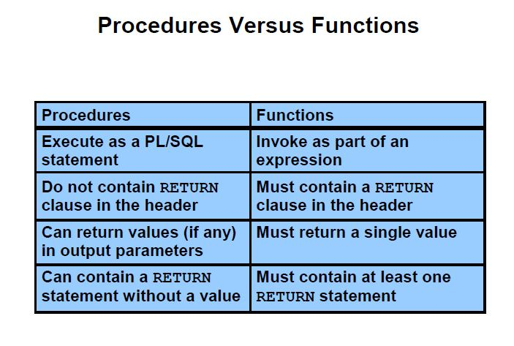
Bordoloi and Bock

Slide 35
Trigger
A trigger is a pl/sql block structure which is fired when the statements like Insert, Delete, Update is executed on a database table.
A trigger is triggered automatically when an associated DML /DDL statement is executed.
Triggers are, in fact, written to be executed in response to any of the following events −
A database manipulation (DML) statement (DELETE, INSERT, or UPDATE)
A database definition (DDL) statement (CREATE, ALTER, or DROP).
A database operation (SERVERERROR, LOGON, LOGOFF, STARTUP, or SHUTDOWN).

Slide 36
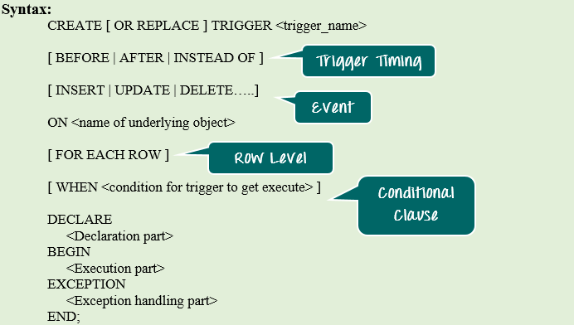

Slide 37
BEFORE/ AFTER will specify the event timings.
INSERT/UPDATE/LOGON/CREATE/etc. will specify the event for which the trigger needs to be fired.
ON clause will specify on which object the above-mentioned event is valid. For example, this will be the table name on which the DML event may occur in the case of DML Trigger.
Command "FOR EACH ROW" will specify the ROW level trigger.
WHEN clause will specify the additional condition in which the trigger needs to fire.
The declaration part, execution part, exception handling part is same as that of the other PL/SQL blocks. Declaration part and exception handling part are optional.

Slide 38
:NEW and :OLD Clause
NEW – It holds a new value for the columns of the base table/view during the trigger execution
:OLD – It holds old value of the columns of the base table/view during the trigger execution
 | INSERT | UPDATE | DELETE
:NEW | VALID | VALID | INVALID. There is no new value in delete case.
:OLD | INVALID. There is no old value in insert case | VALID | VALID

Slide 39
Benefits of Triggers
Triggers can be written for the following purposes −
Generating some derived column values automatically
Enforcing referential integrity
Event logging and storing information on table access
Auditing
Synchronous replication of tables
Imposing security authorizations
Preventing invalid transactions

